Slide 1
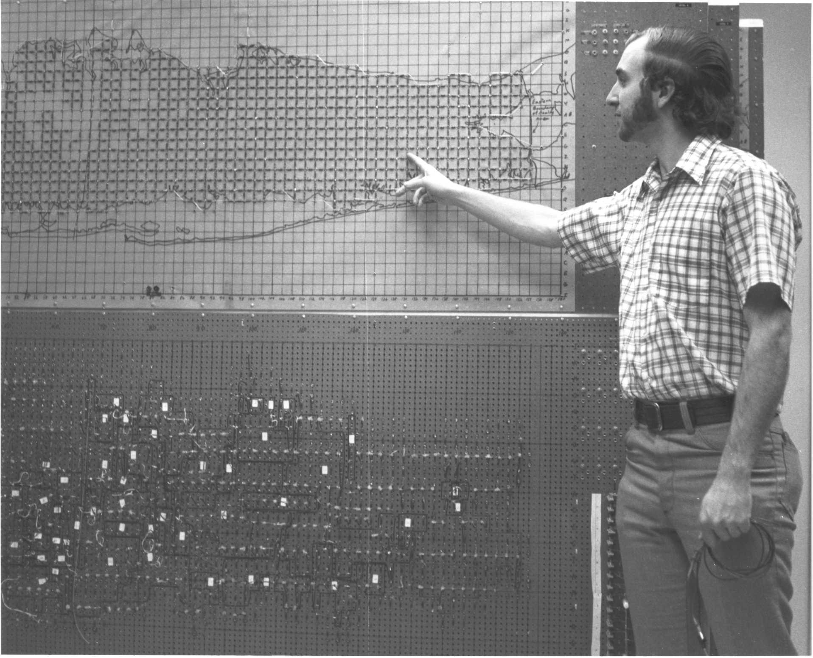
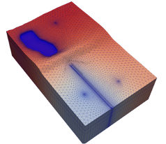
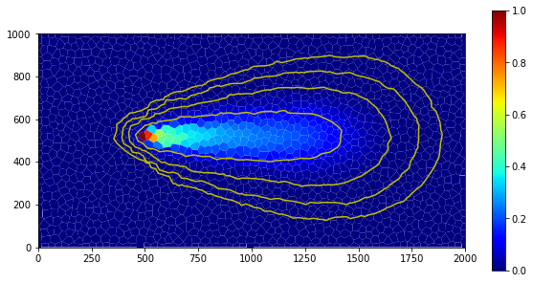
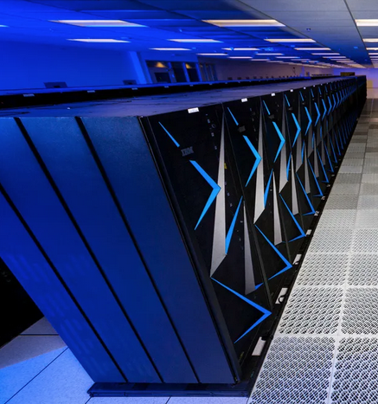


Introduction to Parallel Computing
Parallel MODFLOW Training Class, July 13-14, 2023, Lakewood, CO
Notes:
Why parallel?
Different forms of parallelism, which one for MODFLOW 6?
Theoretical expectations on performance?

Slide 2
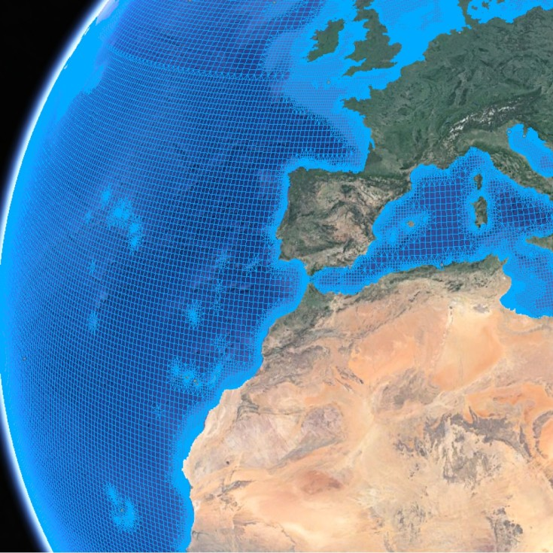
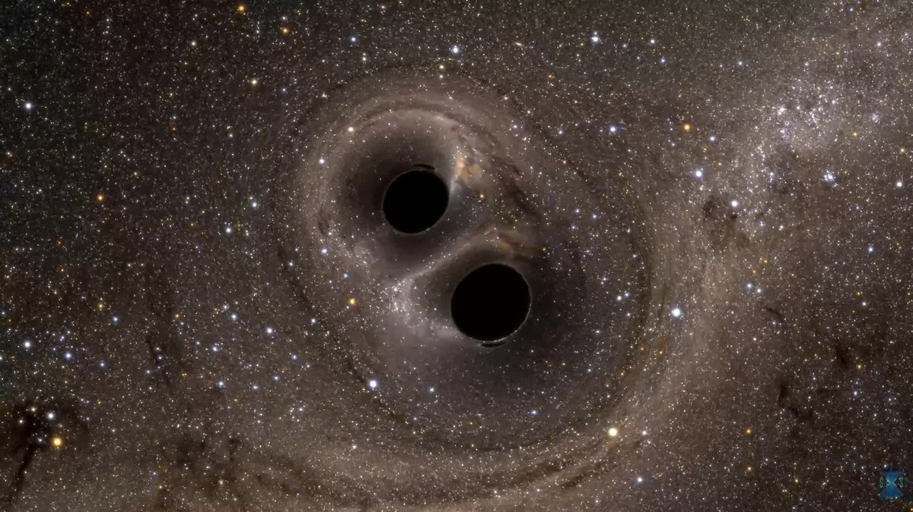

Computational Challenges
Large domain size
Complex calculations
Interaction of small and large scales
Why would you need a supercomputer?
Towards national/continental scale hydrologic models
Not there yet, why?
Notes:
Examples of large scale problems, challenging and typically solved on supercomputers
Large-scale (national/continental) Integrated Hydrologic Models present similar challenges
Why lagging? Perhaps due to large parameter uncertainties of the simulated domain? So a lot of attention has gone to (distributed) Parameter Estimation

Slide 3
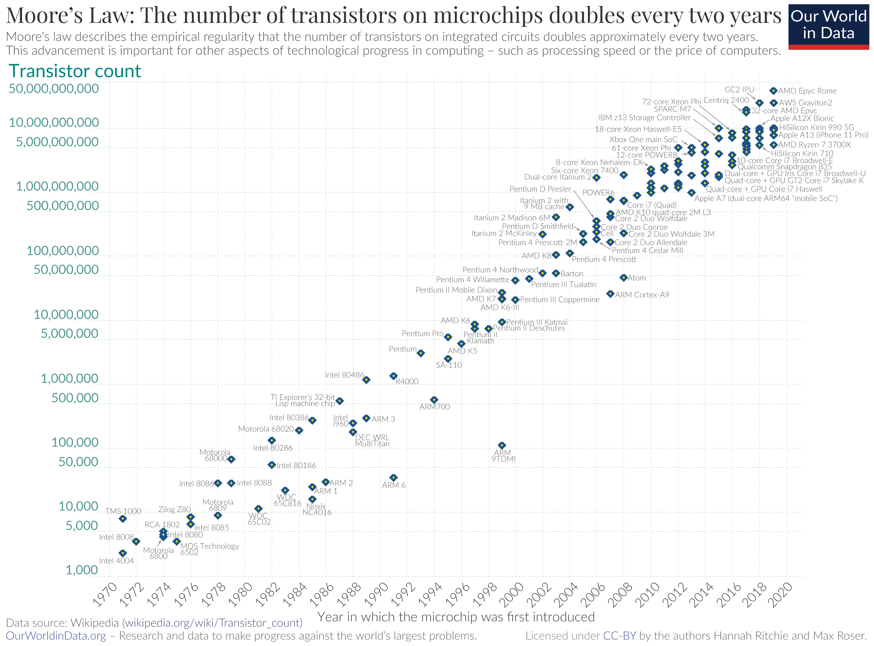
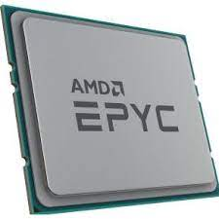
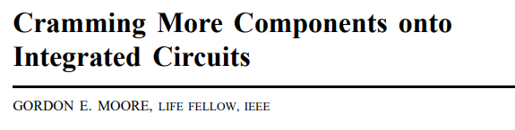

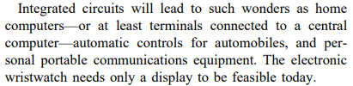
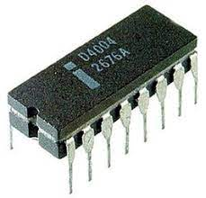
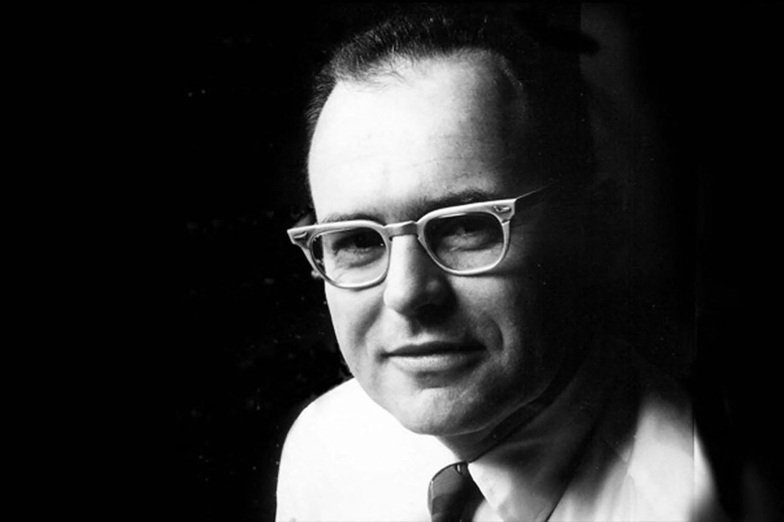
from Electronics, pp. 114–117, April 19, 1965
Gordon Moore (1929-2023)

Slide 4
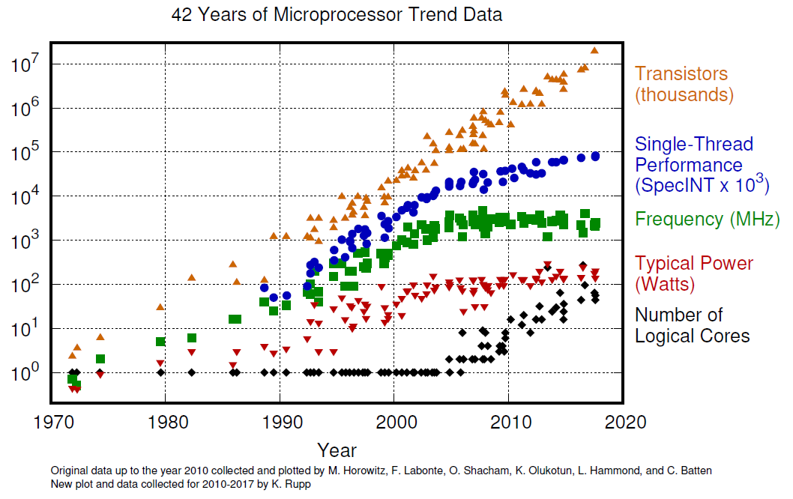
Moore’s Law: the end of it…
Why haven’t clock speeds increased, even though transistors have continued to shrink?
Notes:
Why haven’t clock speeds increased, even though transistors have continued to shrink?
Dennard Scaling postulated that as transistors get smaller their power density stays constant, so that the power use stays in proportion with area. This allowed CPU manufacturers to raise clock frequencies from one generation to the next without significantly increasing overall circuit power consumption. But there was a limit to how long this would last. Smaller devices with thinner dielectrics and shorter channels are more prone to leakage.

Slide 5
Overnight Law
“Every new generation of models we have more data, demand higher precision, increase the complexity of our calculations…”
“… yet with the new laptops, we can still run our models overnight and present results in the morning…”
No more free lunch, at least not without extra work to have your software benefit from
the increase of the nr. of cores in a PC
novel accelerator hardware (GPU, TPU, FPGA, QC)

Slide 6
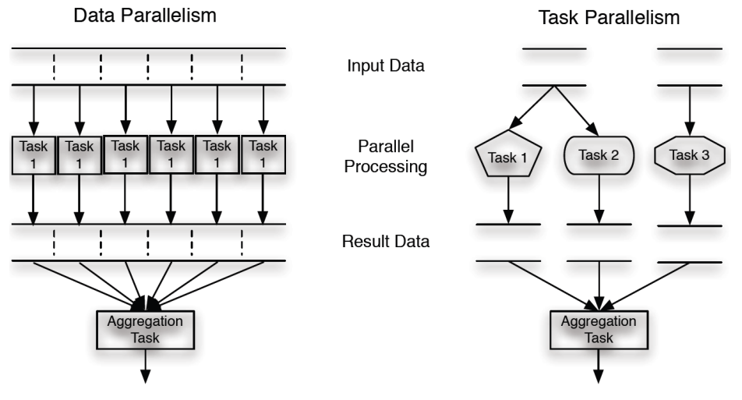
Parallel Computing
Bit level
Instruction level
Data parallelism
Task parallelism
Our strategy: Data Parallelism,
for speed and memory distribution
Notes:
So if you want to speed up, you go parallel!

Slide 7
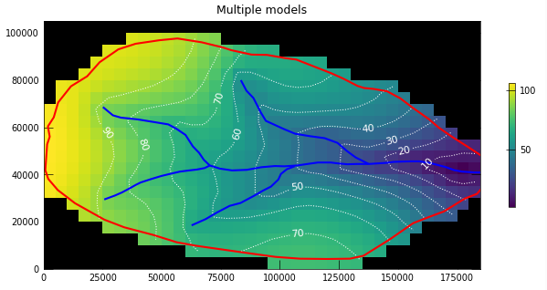
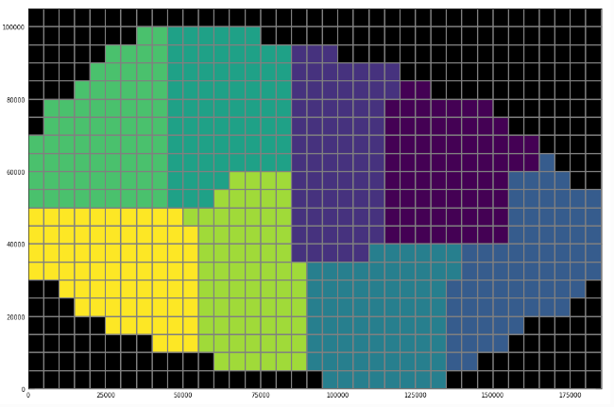

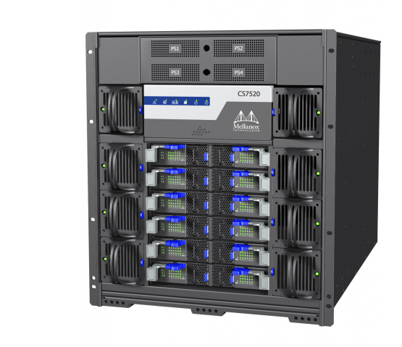
Parallel Computing
Notes:
So if you want to speed up, you go parallel!

Slide 8
Parallel Computing Communication
throughput
SEND
∝ Bandwidth
time
Efficient communication key to parallel performance
Bandwidth, Latency, Message size determine Idle Time
Optimize?
Maximize throughput
Reduce latency
Minimize message size
throughput
∝ Message Size
RECV
Latency
time
Idle Time

Slide 9
Parallel Computing Communication Efficiency
Bandwidth and latency are properties of the hardware
Developer can reduce latency by bundling messages
Modeler can reduce message size by splitting a domain into subdomains in an optimal way:
How to split a model with 4 layers, 200 rows, 1000 columns into 4 subdomains?
Over layers: up to 400k remote cell connections in a subdomain
Over rows: 8k
Over columns: 1.6k

Slide 10
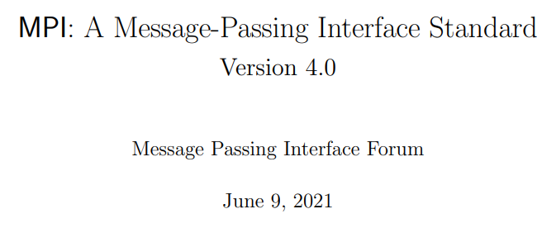
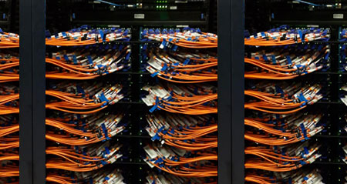
Parallel Computing Message Passing Interface
Standard:
MPI: Message Passing Interface for exchanging data
Standardized and portable
Different implementations:
MPICH, OpenMPI, Intel, MS, and e.g. Cray-MPICH
Messages can be routed over LAN (PCs, Clusters)
Messages routed over fast interconnect, e.g. Infiniband/Omnipath/… (Supercomputers)
Latency can vary from ms to μs!
Infiniband:

Slide 11
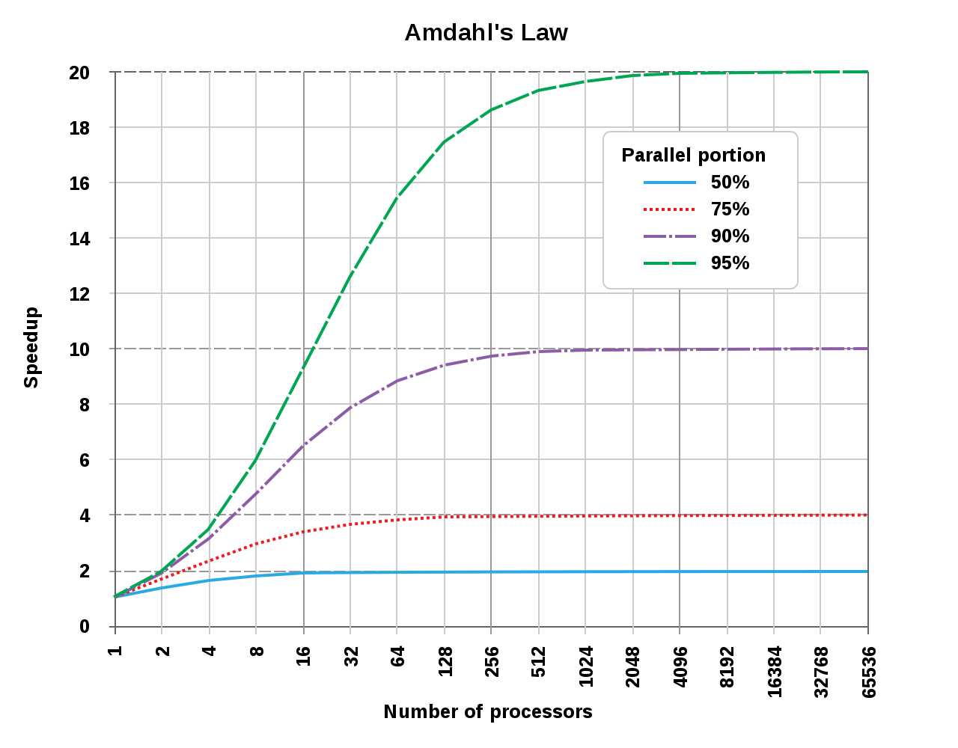
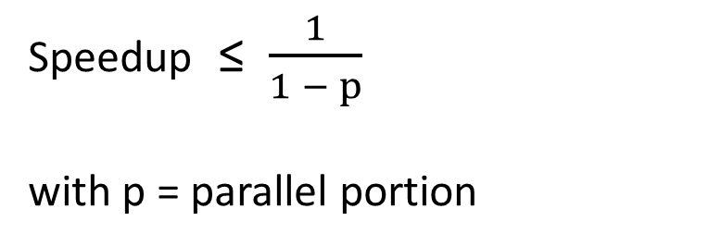
Limit on Speedup
Further division of the work (i.e. smaller domains, increase in processor cores) increases communication overhead
Put differently: how large can you make your model?!
Amdahl’s law:
Speedup ≤ $\frac{1}{1 − p}$
with p = parallel portion
Notes:
How much faster can you get?

Slide 12
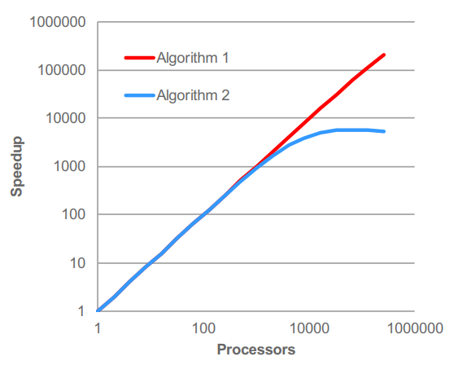
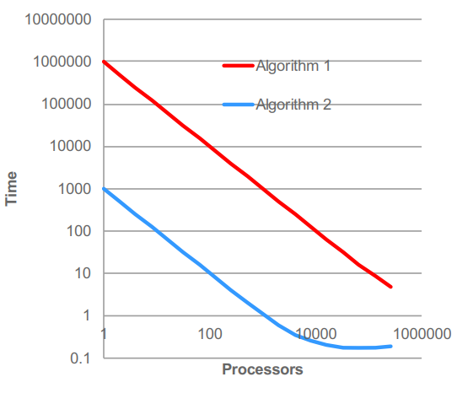
A note on Speedup
Should I use Algorithm 1 or Algorithm 2?
How about now?
Figure by W. Gropp
Figure by W. Gropp
A modeler cares about Time to Solution!
Notes:
You can always improve the scaling by destroying performance per processor and/or by choosing a very computationally expensive algorithm

Slide 13
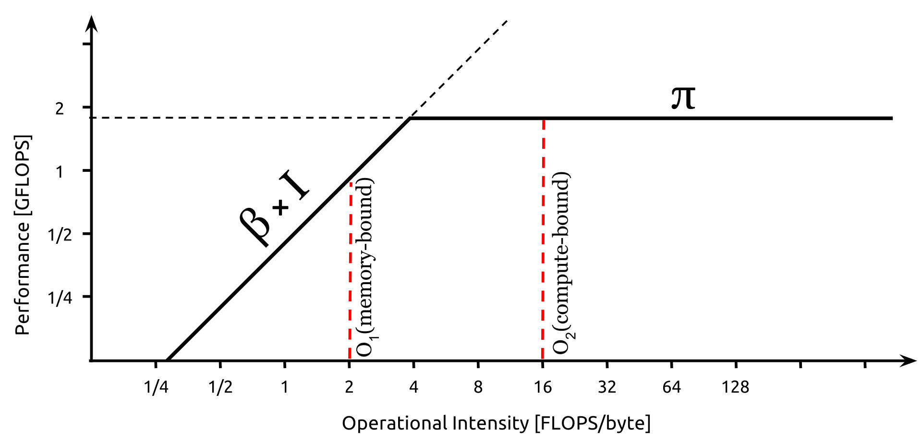
Limit on Memory Bandwidth
π = Peak Performance
β = Peak Bandwidth
I = Arithmetic Intensity
Roofline Model:
Example: DAXPY
_{DO i = 1, N}
_{y(i) = a*x(i) + y(i)}
_{END DO}
_{24 Bytes (2 load, 1 store)}
_{2 FLOPS, 1 ADD and 1 MUL}
_{which gives 1/12 FLOPS/Byte}
CG method: OI ≈ 0.4
i.e., a higher peak performance
will not lead to a shorter run time…

Slide 14
Memory Bandwidth Bound
ideal
= 4 ppn ($$$$)
= 8 ppn ($$)
speedup
= 16 ppn ($)
nr. of processors

Slide 15

Questions?

Slide 16
Parallel MODFLOW 6: Expectations
Reduce simulation run time
Deal with increasing model size
National, Continental scale
Integrated, Multi-process
Increase size of models…
Distribution of memory load
Fit really large problems on a machine

Slide 17
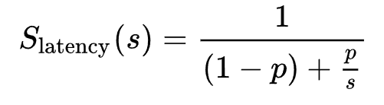
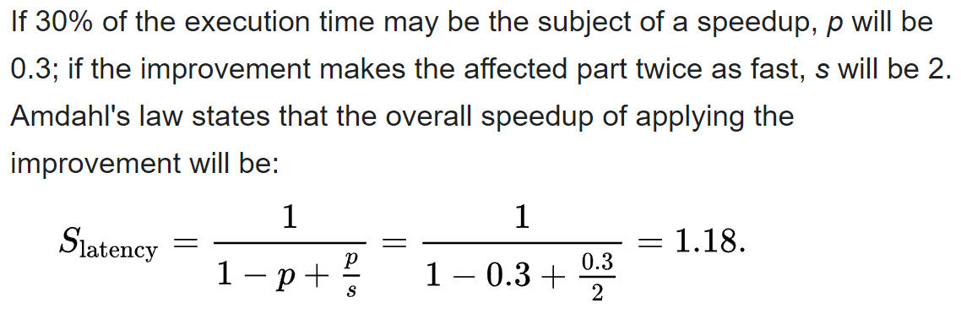
Amdahl Example

Slide 18
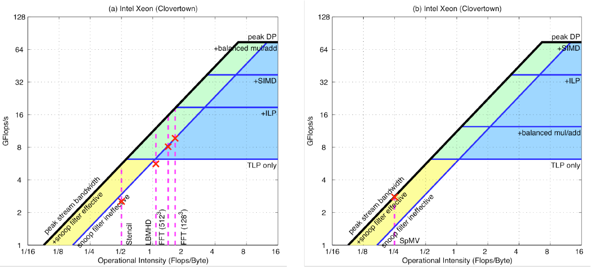
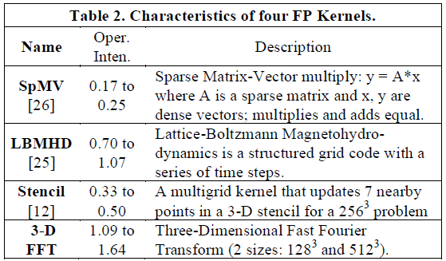
Roofline

